Slide 1
How clinicians use data to make an impact on clinical outcomes
Pawan Randev
GP Cancer Lead EMSCN
GP Lead WLCCG
GP Trainer and Appraiser

Slide 2
Primary Care Use of Data
Direct Patient Contact
Practice Level Data
Locality/Federation Level
CCG Level
SCN Level Strategy
Notes:
Direct Patient Contact – making clinical decisions

Slide 3
What GPs can use data for
GPs generate data!!
Patient Care
Audit
Benchmarking
Practice QI
Revalidation

Slide 4
Clinical engagement – the front line
Data – the numbers
Information – What the numbers mean in my practice? Am I doing well or not?
Useful Knowledge – How does it alter my patient management?
Wisdom – Sustained Practice level changes
Notes:
Always linking to patients

Slide 5
What is the challenge?
13,000 patients
>50,000 consultations per year
270, 2 week wait referrals per year
60 New Cancers per year
Qualitative (narrative) vs Quantity
Notes:
Measham data
8-12 from screening
Cancer is a small part of the overall activity of general practice
How to see, own and manage own data and the reward for so doing

Slide 6
Begin and end at the patient
Notes:
The general principle is to begin and end at the patient when working with primary care

Slide 7
Begin and end at the patient
Patient Records
Prompts
Risk Calculators
Notes:
The elements that GPs use every day

Slide 8
Notes:
EMIS Web – 50-60% of all systems
SystmOne and Vision

Slide 9
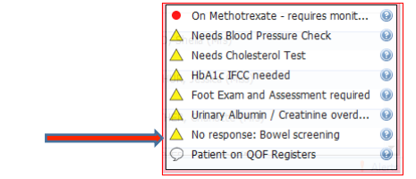
Prompts
Notes:
Letter to Patients

Slide 10
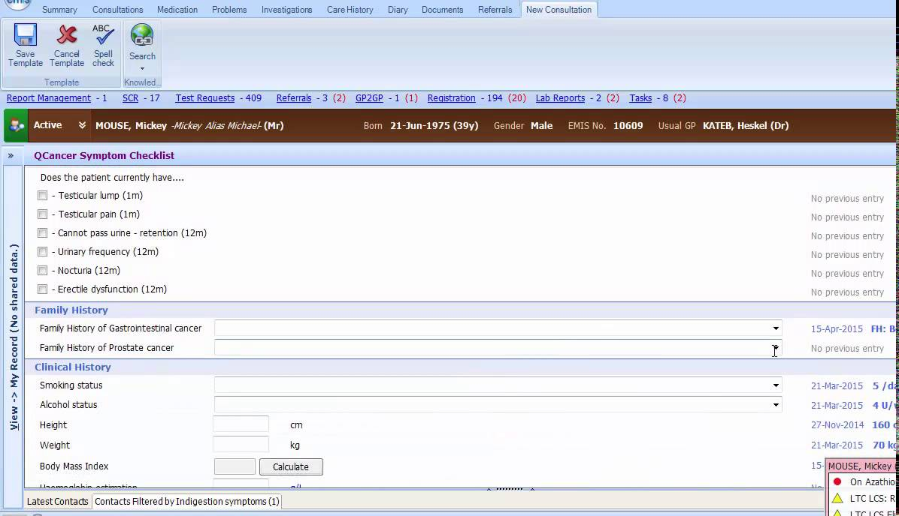
Qcancer – Emis Web

Slide 11
Begin and end at the patient – Practice Level Indicators
QoF – New Cancers diagnosed
Practice Profiles
Cancer Audits
Cancer SEAs
Notes:
11 years worth of Qof cancer data

Slide 12
Begin and end at the patient – Practice Profile Domains
Notes:
& stage at diagnosis

Slide 14
Practice Profile

Slide 15
New Cancers Audit

Slide 16
A real audit

Slide 17
Cancer SEA
Notes:
Discussed at practice meetings and at appraisal
Need Training

Slide 18
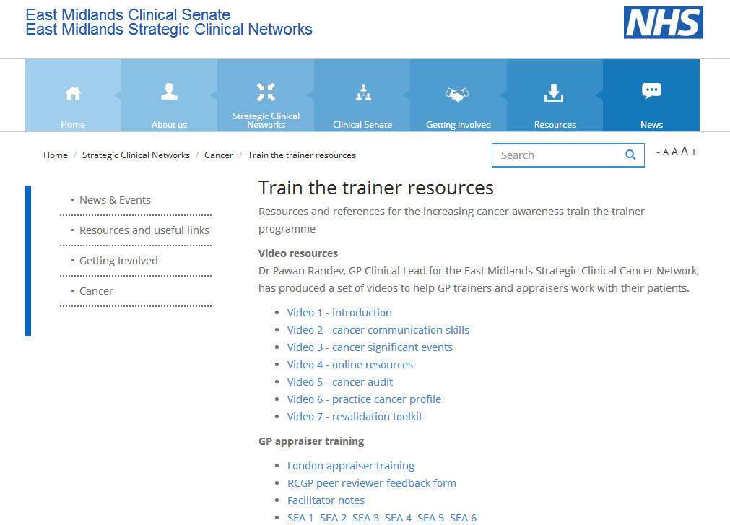
Notes:
GPs need training to understand the data and how to apply it

Slide 19
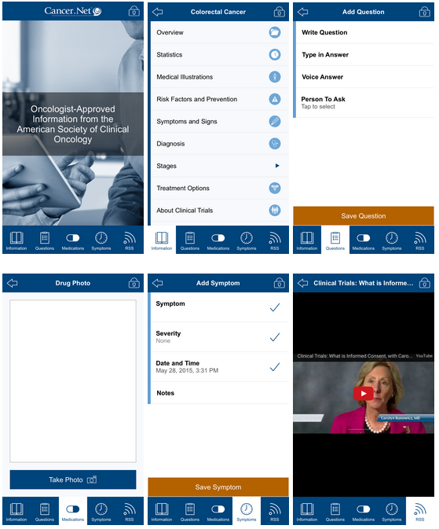
Begin and end at the patient – Integrating the data
Notes:
Patien t Level
Whose data?

Slide 20
Begin and end at the patient – Engaging the Clinicians
Bringing together data (feedback) on individual and practice performance in order to produce sustainable change
Motivate, educate and reward professionals
Multi-use data (appraisal/governance)
Recognise the environmental challenges
Work with CCGs/Federations/PH/Patients
Notes:
Patient Level

Slide 21
Begin and end at the patient – Questions?
Notes:
Patient Level

