Slide 1
How clinicians use data to make an impact on clinical outcomes
Andrew Brodbelt
Consultant Neurosurgeon and Clinical Director of Neurosurgery, The Walton Centre NHS Foundation Trust
Member of CNS SSCRG, National Cancer Intelligence Network

Slide 2
The core objective:
link data with patient outcome
Promoting data collection
National repository datasets
Expert analyses
Improve standards of care and outcomes
Support audit and research

Slide 3
Clinical engagement
Key issues & priorities
Ownership: Develop, encourage, QA
Analytical programme
Reporting
Communication
Research

Slide 4
What clinicians use data for
Audit
Peer Review
Research
Revalidation

Slide 5
My Journey
Neuro-oncology lead
MDT Chair
CNG Chair
Interested in Incidence and outcome
Regional data
NCIN

Slide 6
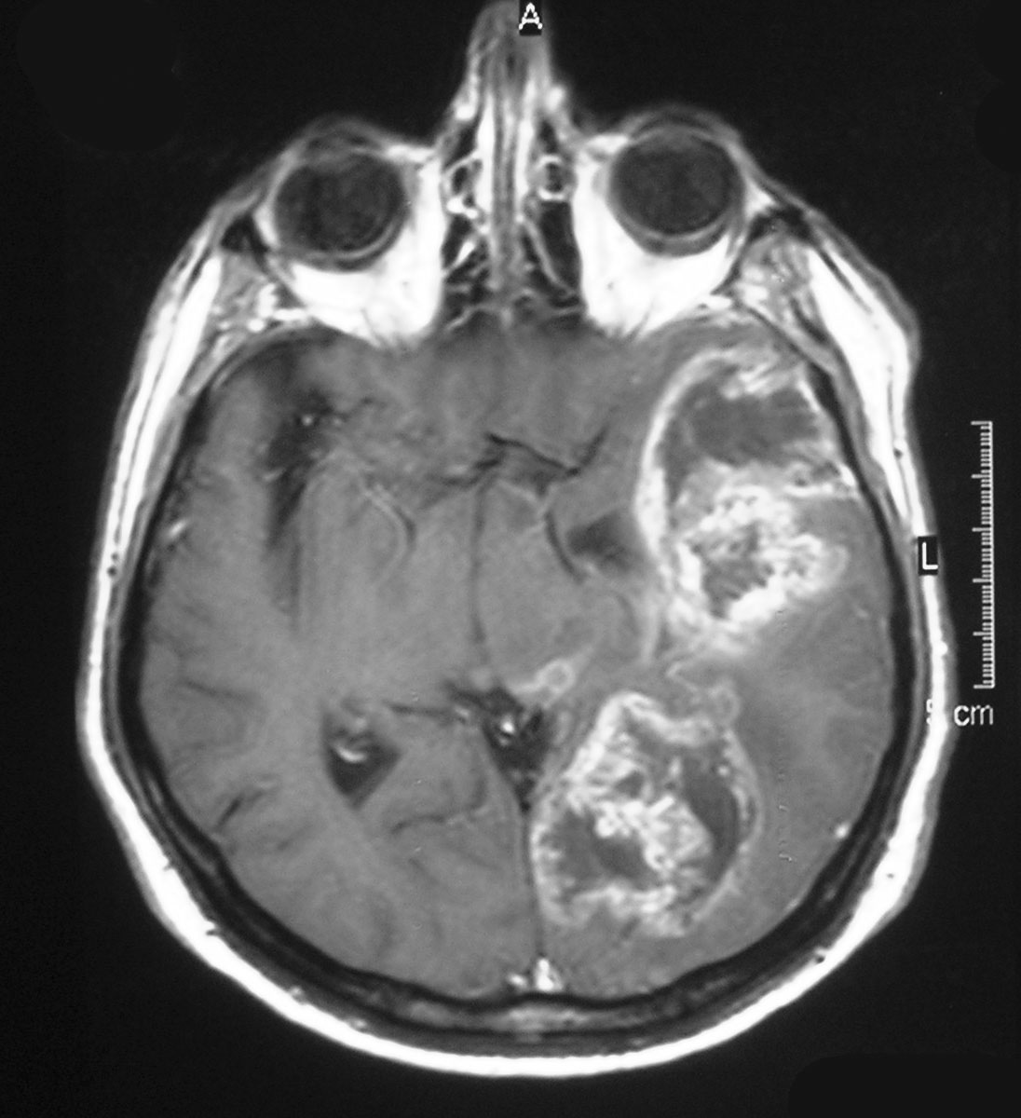
What is the outcome in the UK for patients with glioblastoma?
Commonest primary malignant brain tumour
Malignant incidence 5.3/100,000
West
Median 6 - 9 month

Slide 7
UK national data rare.
Jan 2007 – Dec 2011
National cancer registration service
Hospital Episode Statistics (HES)
NHS Personal Demographic Service
Radiotherapy data not complete until 2012
England only
Notes:
Note not HGG/ Glioma otherwise specified. We tried to look at a pure set of GBM patients.

Slide 8
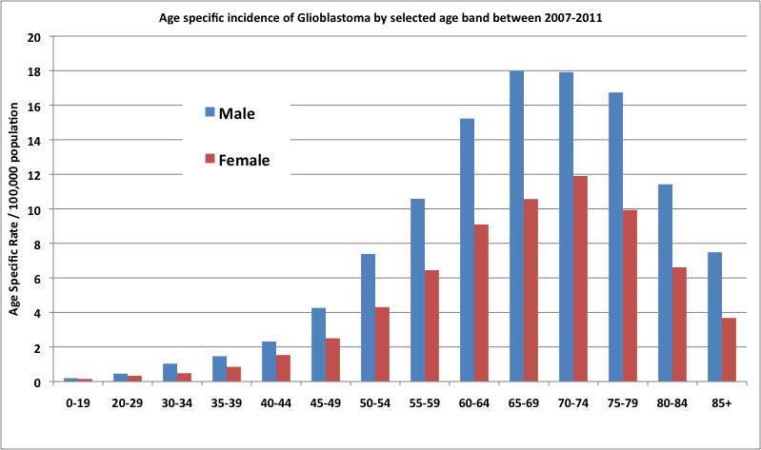
Age adjusted incidence: 4.64/100,000
Notes:
Age adjusted incidence peaks between 65 and 75 and gives an overall incidence of 4.64. This age adjusted incidence is the highest reported world wide. This may be that other countries are not accurately recording incidence data for GBM specifically rather than there being an actual difference.

Slide 9
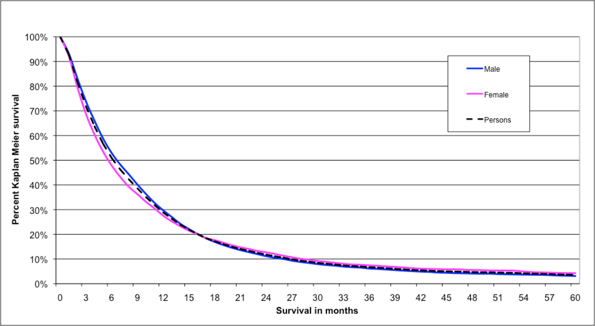
Overall survival remains low
6.08 months
28.4%
3.4%
Notes:
There was no significant difference between men and women

Slide 10
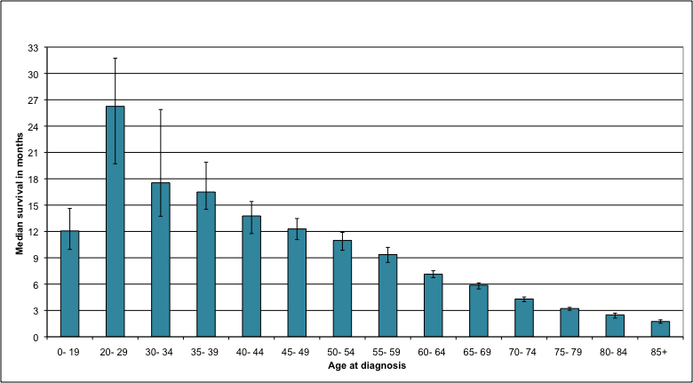
Patient age is important
16.2 months
7.9 months
3.2 months

Slide 11
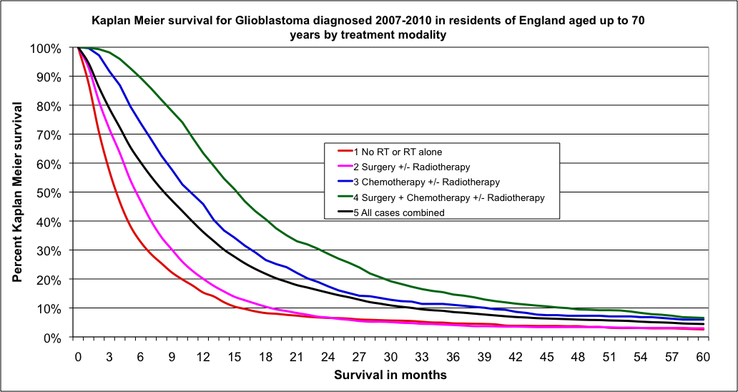
The effect of treatment
3
5
10
14

Slide 12
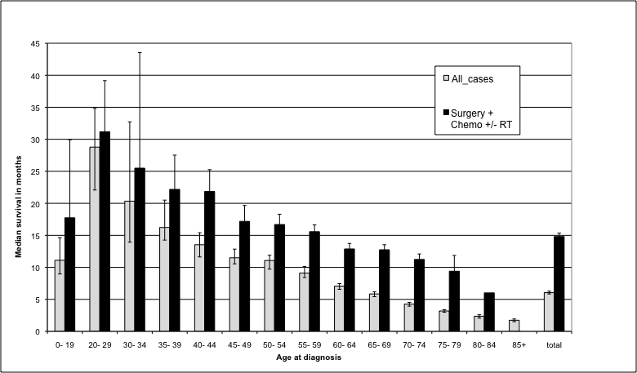
Maximal Treatment improves survival at all ages
European Journal of Cancer, 2015

Slide 13
How can this help with my clinical management?

Slide 14
Need to increase the numbers treated aggressively
Over 70 years
Maximal treatment if possible
If not discuss no treatment
Is anyone cured?

Slide 15
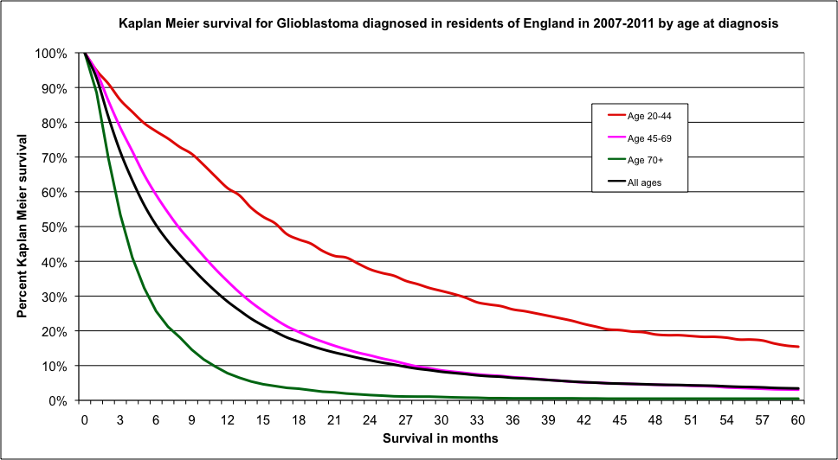
Some patients survive long term
Notes:
This Kaplan Meir survival graph demonstrates the effect of age on outcome, and interestingly appeared to have a 5 year survival group. 3.4%overall with the youger age having a five year survival of over 15%

Slide 16
17,786 patients with Glioblastoma
938
484
Case by case
256
Possible
96
Definite
Deduplication
Notes:
Progression from lower grade. Tried to go off definite histology report of GBM wherever possible

Slide 17
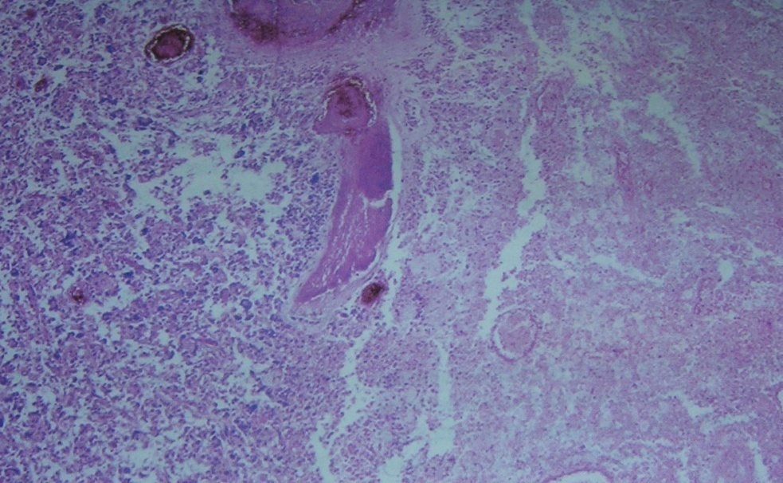
Pathology
94 Glioblastoma
? GBM-O
2 Giant cell glioblastoma

Slide 18
Young age, and equal sex
Notes:
Long term survivors are much younger than the overall GBM case profile, but a few were aged 60+. See next slide for comparison

Slide 19
Treatment profile
70%
25%
VS
Notes:
Radiotherapy assumed! More maximal treatment since 2006
70 % vs 25% overall nationally

Slide 20
48 % had multiple operations.
Debulkings | Patient Numbers
1 | 36
2 | 25
3 | 15
4 | 3
5 | 1
6 | 1

Slide 21
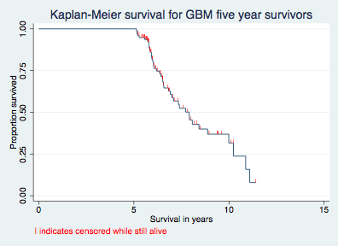
A late recurrence rate
5 year survival 3.4% from diagnosis, but 36% at 5 years

Slide 22
Most patients (2/3rds) who survive 5 years will still die of their disease within 10 years of diagnosis

Slide 23
There are study limitations
True Glioblastoma patients?
Need independent check of pathology
Earlier years data sparce
Radiotherapy data assumed
Not the complete cohort
What about the other 256?
Quality of Life

Slide 24
What does this tell us?
Aggressive treatment can lead to longer outcomes?
There are some data limitations
The next step
Is prolonged survival due to the patient, the tumour, the treating clinicians or a combination?
Registered as a national audit

Slide 25
30 day mortality and the ‘50% rule’

Slide 31
30 day mortality after surgical resection of a brain tumour
Dr. Matt Williams
ICHNT & IC
On behalf of the NCIN Brain & CNS SSCRG

Slide 32
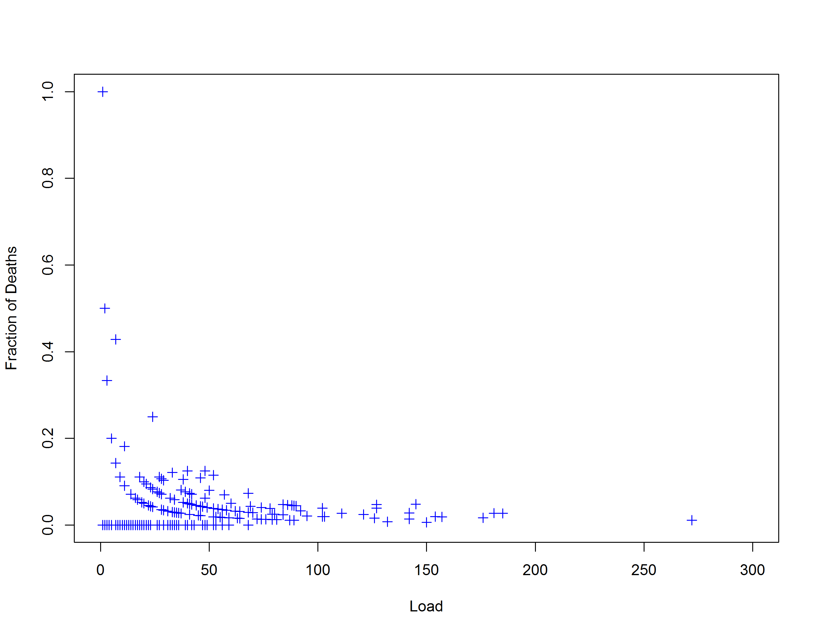
30-day post-operative mortality against # operations in 3 yrs ...

Slide 33
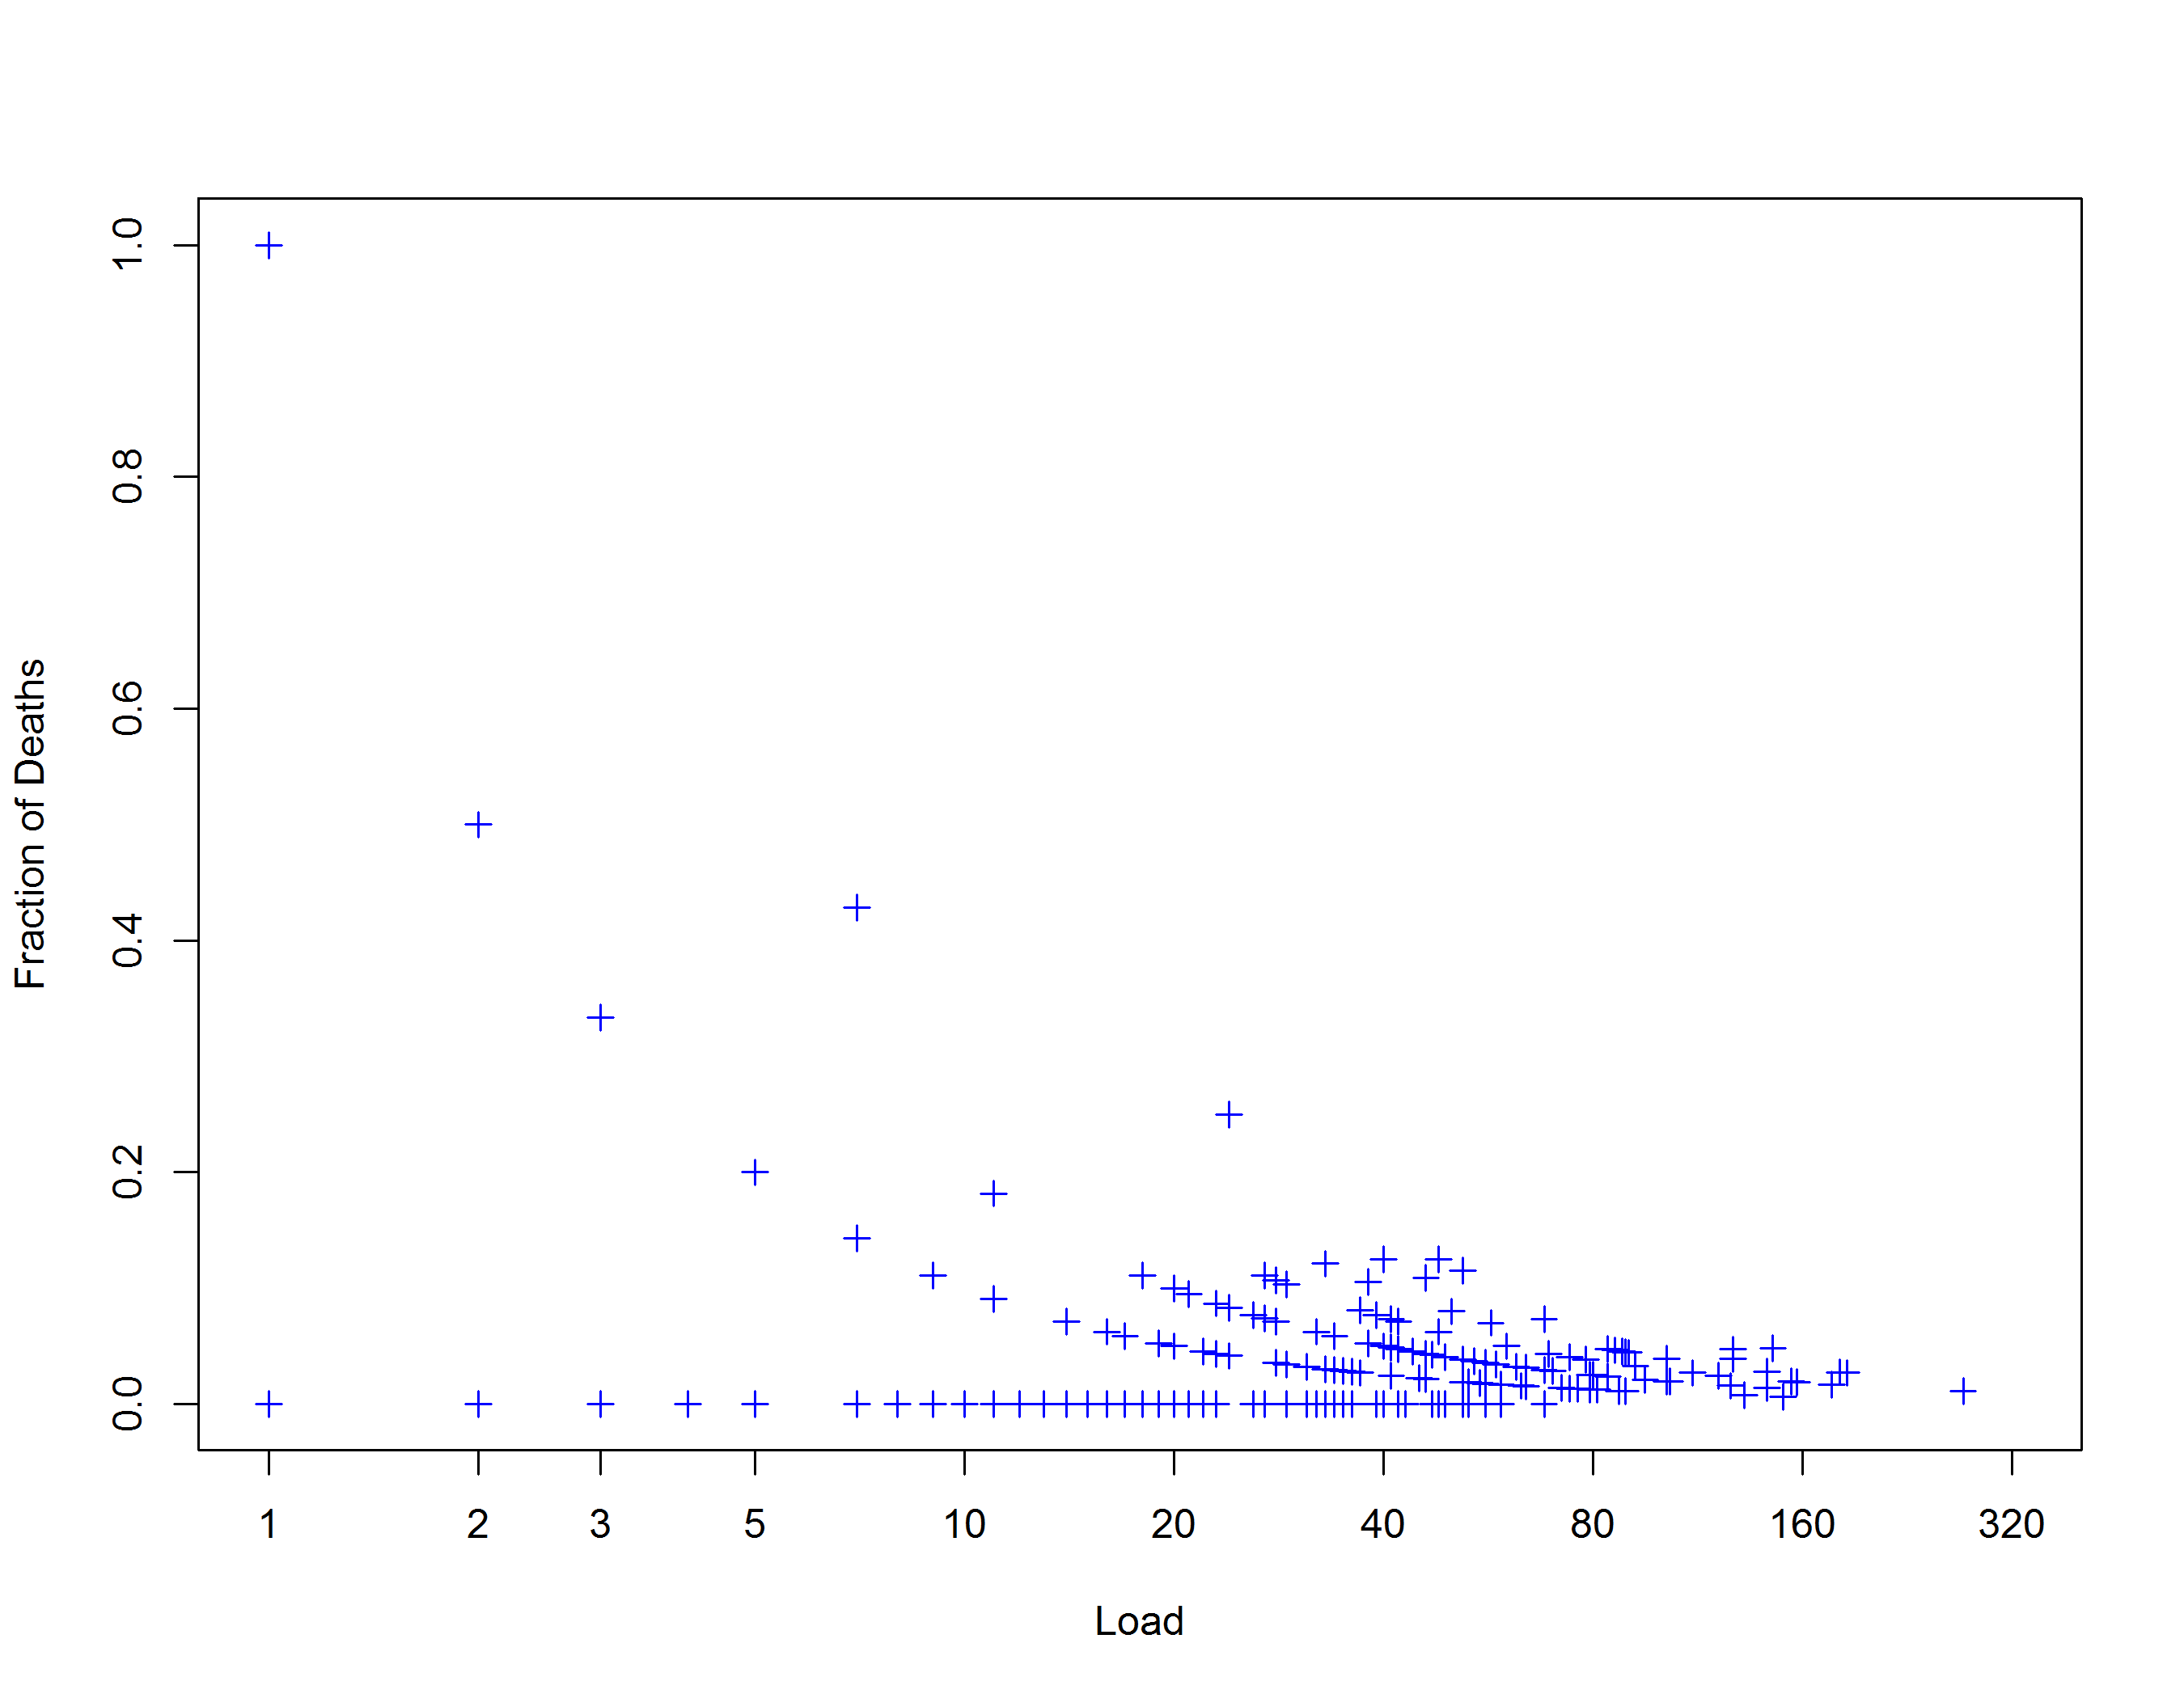
... plotted on logged horizontal scale ...

Slide 34
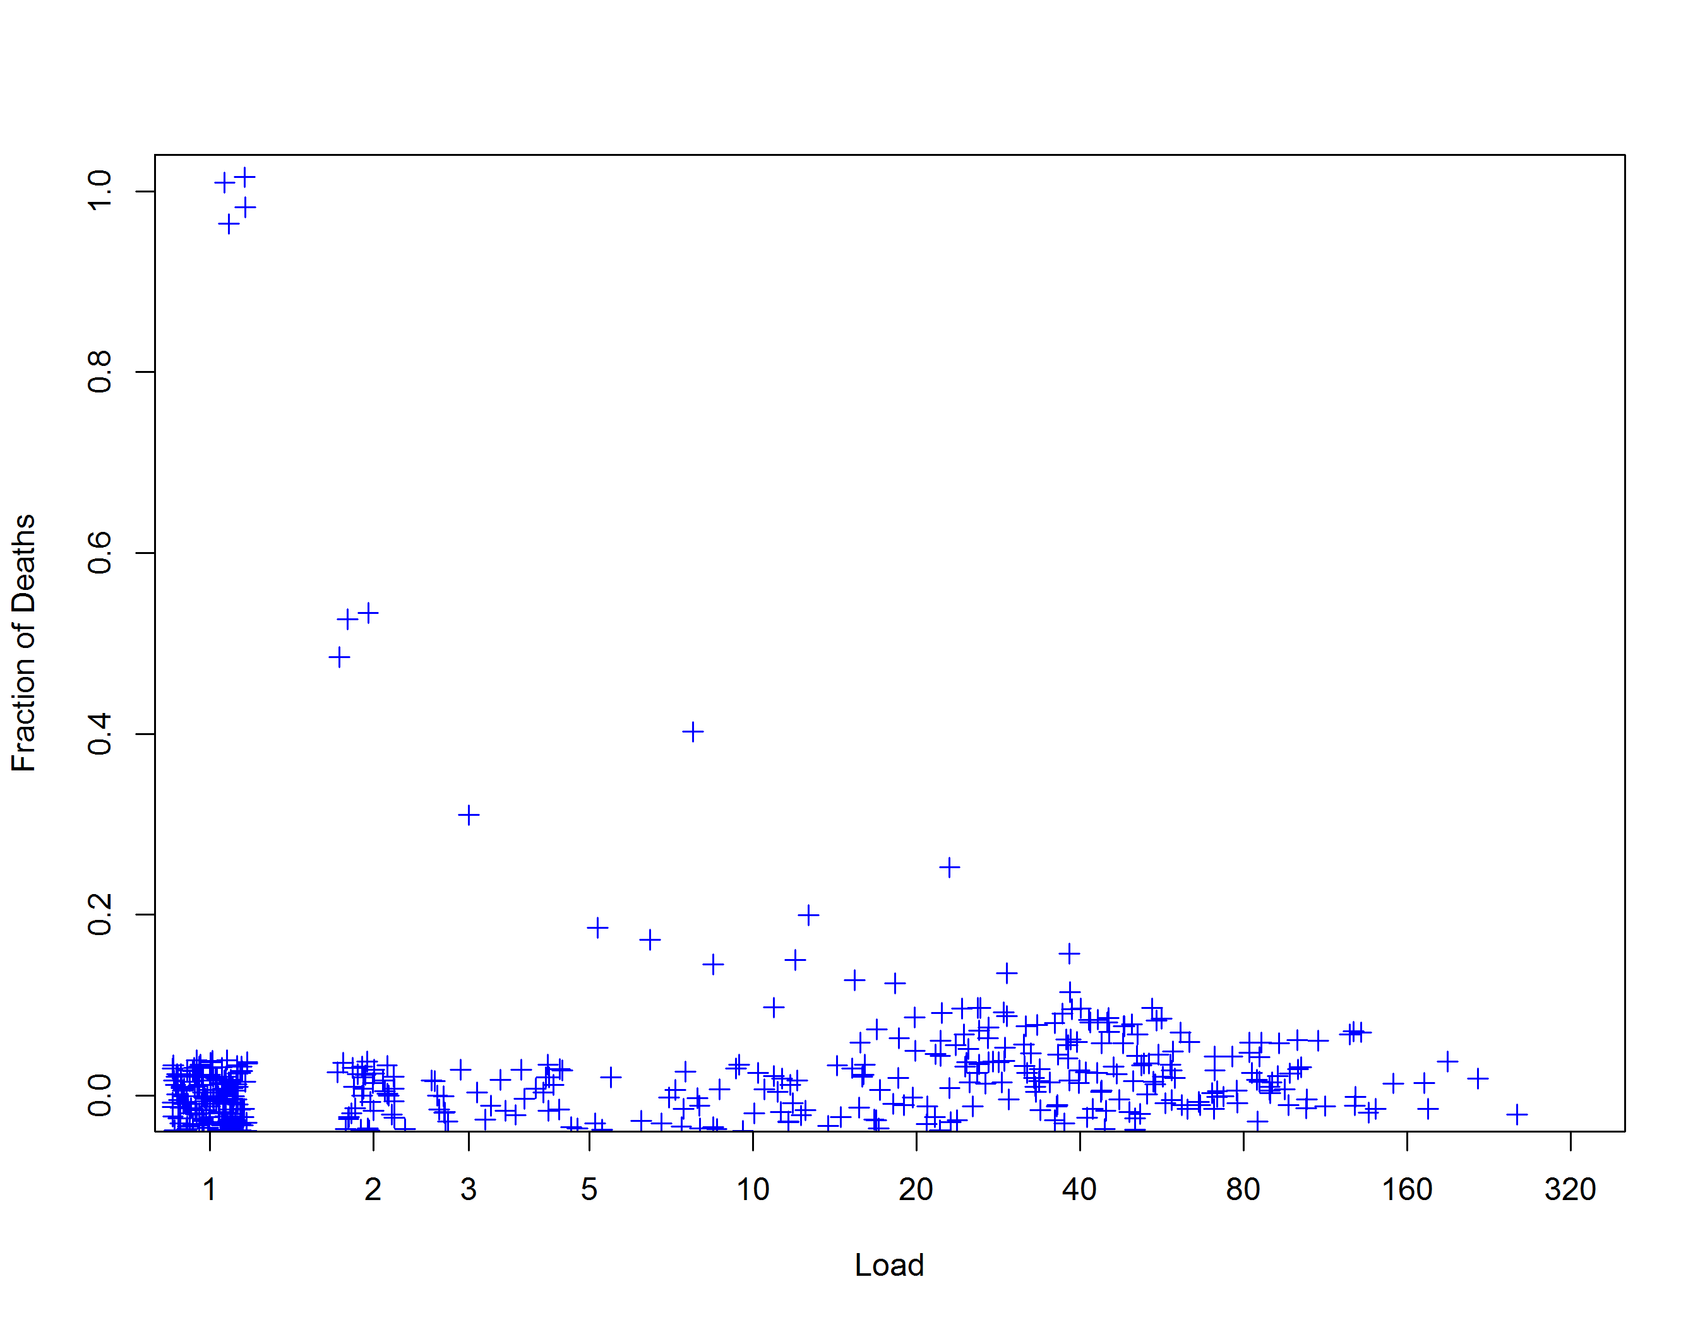
... and jittered to show individual surgeons

Slide 35
Enrichment
very skew distribution of Load:
152 surgeons with only one operation
73 with from one to five operations
0 with six operations
228 with seven or more operations
interest currently in surgeons who operate regularly, so dataset enriched by excluding
surgeons with fewer than six operations
surgeons without at least one observation in both the first and last six months of the three year period

Slide 36
Results
Originally 10888 patients and 453 surgeons at 31 trusts
152 surgeons only did one operation, and others did a few
9194 (84%) patients and 163 surgeons (36%) in 30 trusts
Predominantly brain & meninges
Other rare
30 day mortality was 3%

Slide 37
Results
Lowest surgical activity = 7
Median number = 46 (over 3 years)
Quartiles:
7 – 29
29 – 46
46 – 70
70 - 272

Slide 38
Original dataset ...

Slide 39
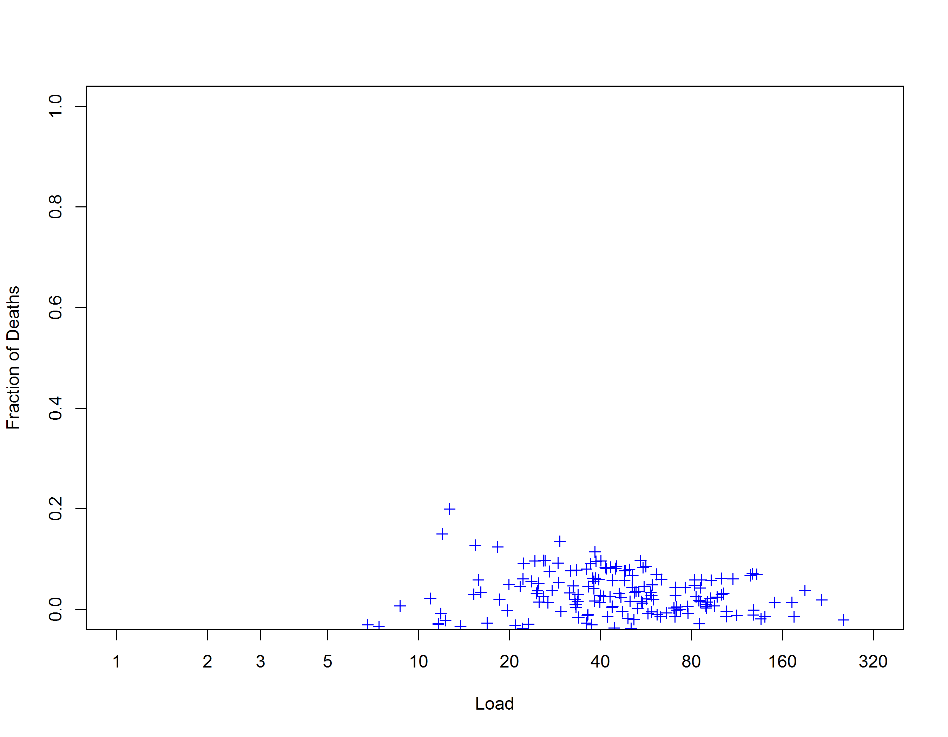
... enriched dataset ...

Slide 40
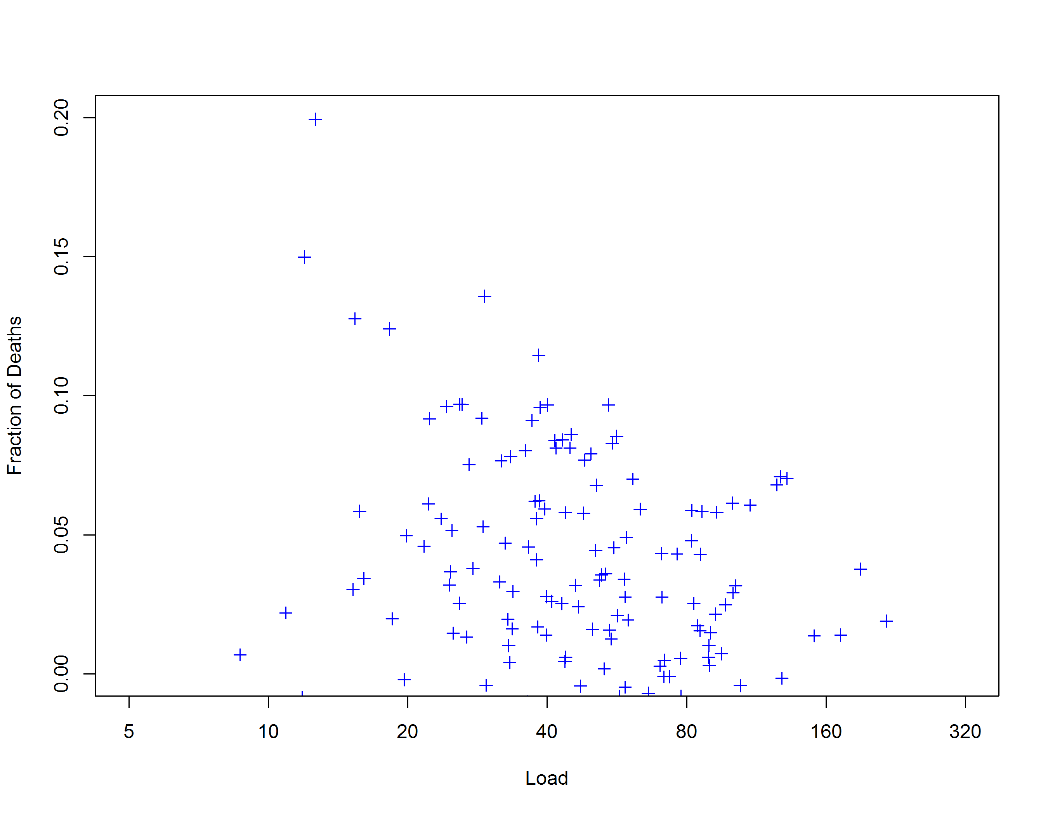
... re-scaled ...

Slide 41
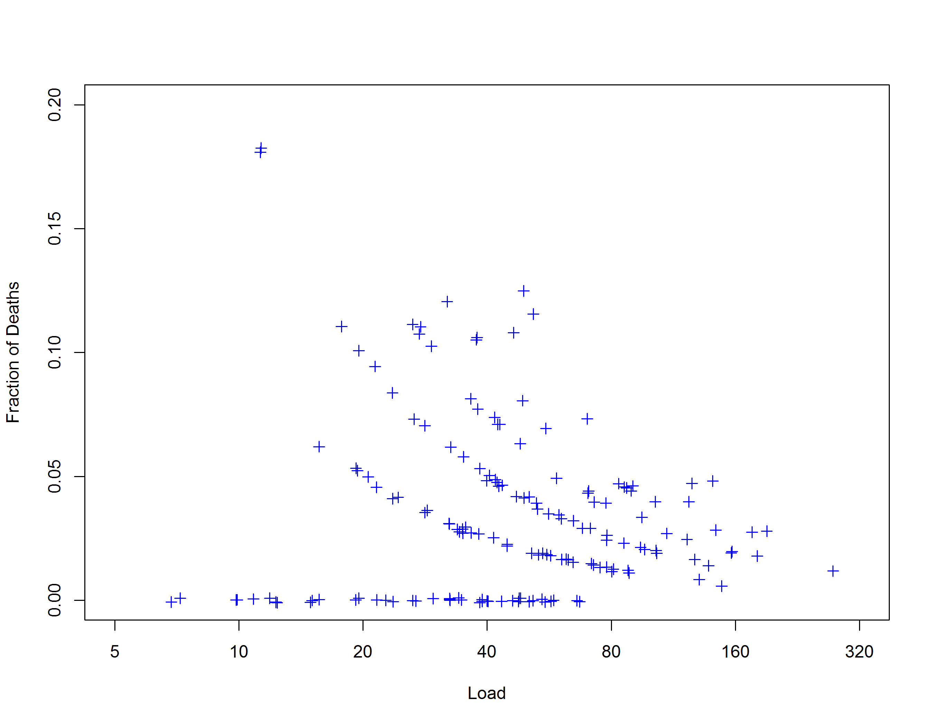
... and most of jittering removed

Slide 42
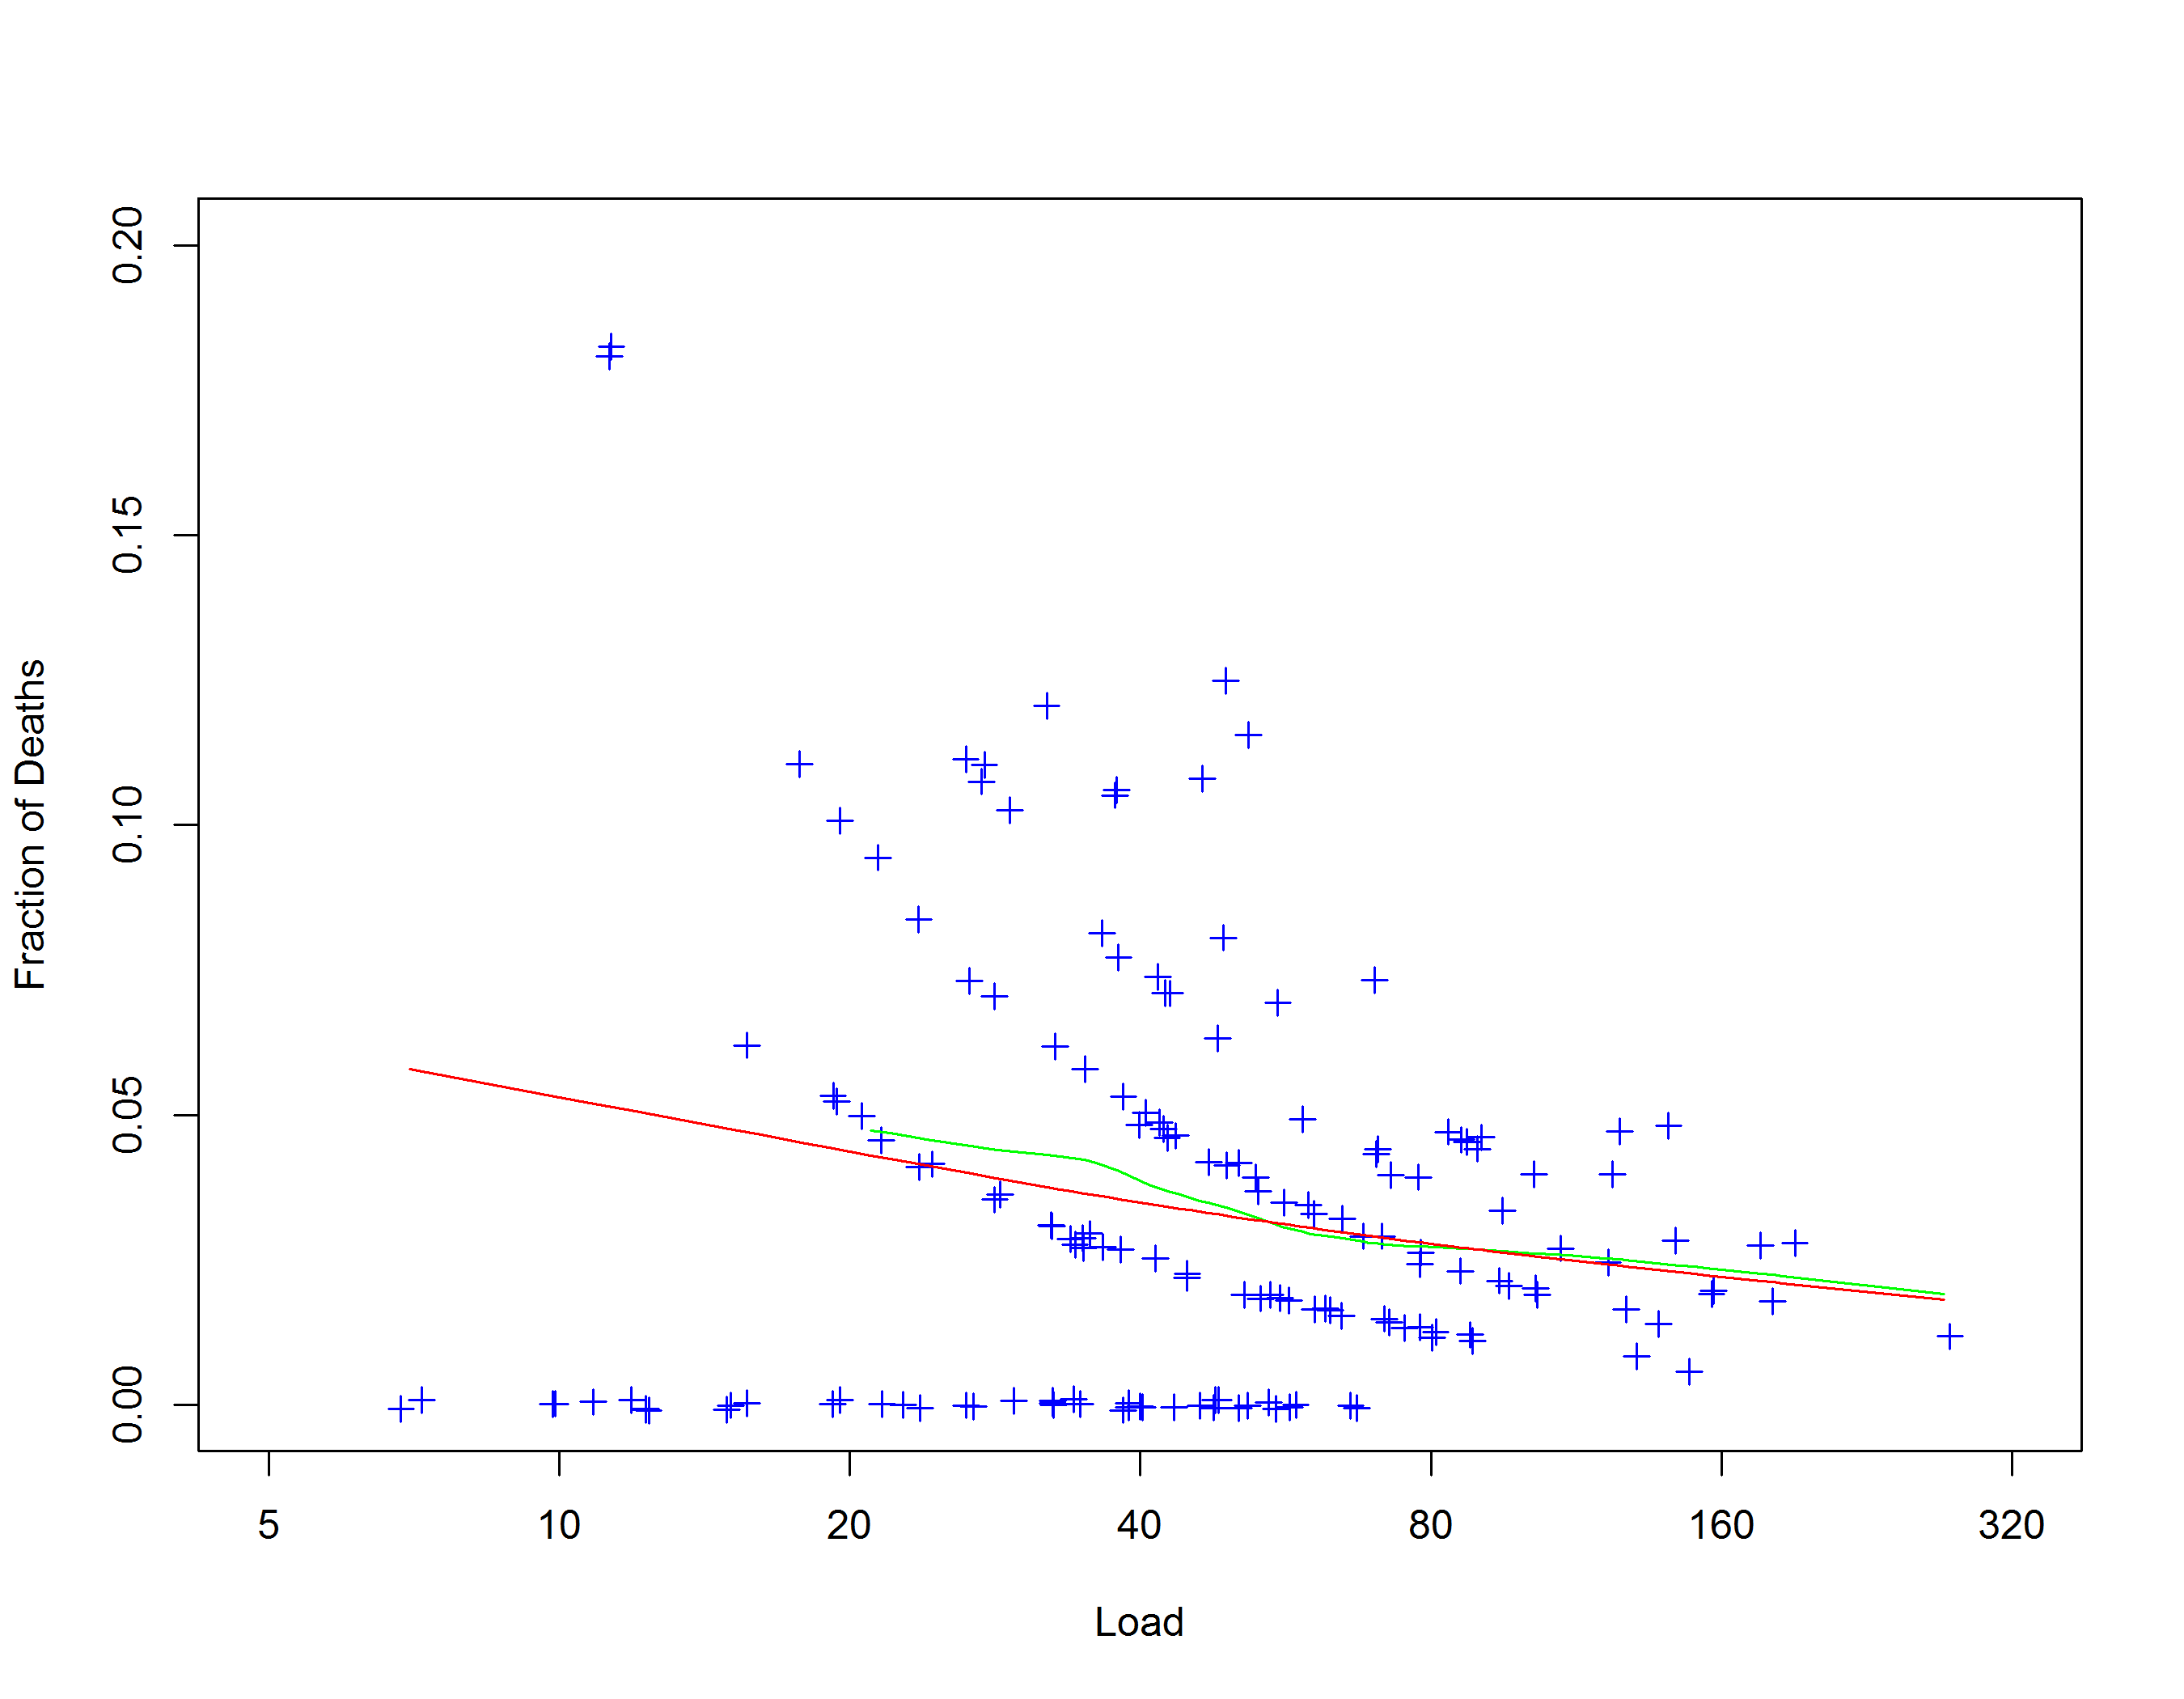
... and prediction from logistic model

Slide 43
Results
Age, deprivation and individual surgeon volume correlated with 30 day mortality
Patient sex & trust volume were not
Same factors preserved on multivariate, on both step-forward and step-backwards analysis of factors
RR for surgeon volume is 0.8, p = 0.0003
20% relative risk reduction in 30 day death for doubling a surgeon’s workload

Slide 44
Conclusions
There is a surgical volume effect
There is probably not a centre volume effect
Because we are already centralised
Moving patients from the least busy ¼ of surgeons to the others (from LVS to MVS):
Needs proper modelling
~700 pts who had surgery with a LVS
Moving them to a MVS turns their absolute risk from ~3% -> 2.4%
4 lives saved @ 30 days
THESE CALCULATIONS ARE VERY PROVISIONAL

Slide 45
Where to from here?
Meningiomas
Long term survivors
Details of radio and chemotherapy
Papers, presentations, and national committees to drive improved care

Slide 46
Get Involved
Improve data collection
Ask the important questions
Use the data to drive clinical change.
At least one clinician per MDT.

